Slide 1
Chapter 5 “A Dual Court System”
Business Law

Slide 2
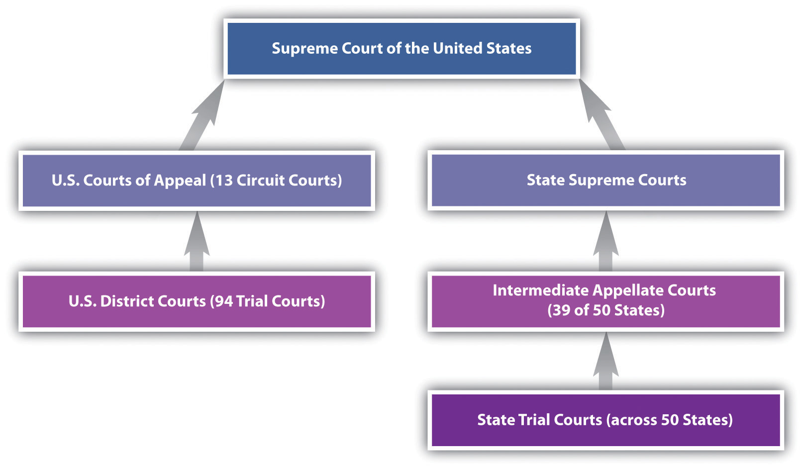
A Dual Court System

Slide 3
A Dual Court System
Federal Court System
Jurisdiction - the power and authority given to a court to hear a case and to make a judgment.

Slide 4
A Dual Court System
Federal courts have jurisdiction over:
1. Actions in which the U.S. or a state is a party, except those actions between a state and its own citizens
2. Cases that raise a federal question (interpretation of the U. S. constitution or the violation or interpretation of a federal law)
3. Diversity of citizenship cases – actions between citizens of different state where the amount of money involved exceeds $50,000
4. Admiralty (pertaining to the sea), patent-right, copyright, and bankruptcy cases

Slide 6
A Dual Court System
District Courts - have original jurisdiction - (the authority to try a case the first time it is heard) over most federal court cases
Courts of Appeals (Appellate Courts)- are intermediate courts between the lower courts and the highest court
They have the authority to hear appeals and review cases from lower courts
Appellate jurisdiction - any party to a suit decided in a federal district court may appeal the decision to the federal court of appeals in the circuit where the case was tried

Slide 7
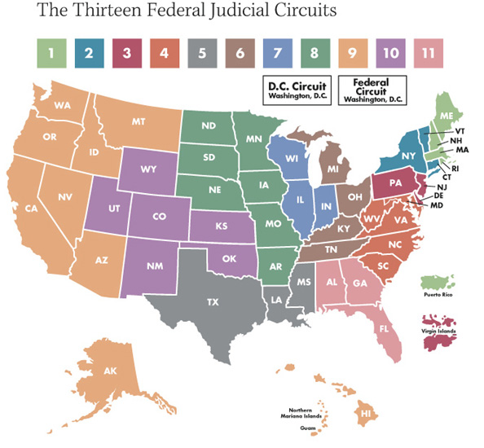

Slide 8
A Dual Court System
Special U.S. Courts - include suits by citizens against the federal government, disagreement over taxes on imported goods, and disputes between taxpayers and the Internal Revenue Service
U.S. Supreme Court - highest court in the land. Appellate jurisdiction is the main function. Has original jurisdiction in all cases involving ambassadors, consuls, other public ministers, and cases in which a state is a party.

Slide 9
A Dual Court System
State Court System
Local Trial Courts - have limited jurisdiction (jurisdiction only in minor matters such as misdemeanors and civil actions involving small amounts of money)
Minor legal matters - traffic courts, police courts, or municipal courts

Slide 10
A Dual Court System
General Trial Courts - (county courts, superior court, court of common pleas, or circuit court) - have general jurisdiction
All cases involving major crimes and large amounts of money
Sometimes hear appeals from lower courts

Slide 11
A Dual Court System
Special Courts - handle specialized cases such as:
land courts, housing courts, family or domestic relations court, probate court, juvenile courts

Slide 12
A Dual Court System
Persons appearing in juvenile courts have no right to a trial by jury or to be released on bail
Hearings are often more informal than other courts
Have special jurisdiction over delinquent, unruly, abused, and neglected children
Most matters are private and open to the general public

Slide 13
A Dual Court System
Intermediate Appellate Courts - hear appeals from the courts of general jurisdiction
Hear cases only on questions of the law, not questions of fact
Only hear arguments from attorneys
Judges study the legal documents and records in the case

Slide 14
A Dual Court System
Supreme Courts - these high courts make final decisions on matters of law that are appealed from the lower courts
Do not retry a case and redetermine the facts
Only decide whether an error was made in the lower courts in determining the law

Slide 15
A Dual Court System

Slide 16
A Dual Court System
US SUPREME COURT
______________________________________
STATE SUPREME COURT
______________________________________
US COURT OF APPEALS (Intermediate)
______________________________________
INTERMEDIATE APPELLATE COURT
______________________________________
US DISTRICT COURT
______________________________________
GENERAL TRIAL COURT
______________________________________
LOCAL TRIAL COURT
______________________________________

Slide 17
A Dual Court System
US SUPREME COURT
APPELLATE JURISDICTION
STATE SUPREME COURT
APPELLATE JURISDICTION
US COURT OF APPEALS (Intermediate)
APPELLATE JURISDICTION
INTERMEDIATE APPELLATE COURT
APPELLATE JURISDICTION
US DISTRICT COURT
ORIGINAL JURISDCTION
GENERAL TRIAL COURT
GENERAL JURISDICTION
LOCAL TRIAL COURT
LIMITED JURISDICTION

